Slide 1
Digital Forensics Evidence Analysis
Dr. Tran The Son
Vietnam – Korea University

Slide 2
Content
Arsenal Image Mounter
OSFMount
Command “diskpart”
Command “net use”
Autopsy
Fireeye tools
Volatility

Slide 3
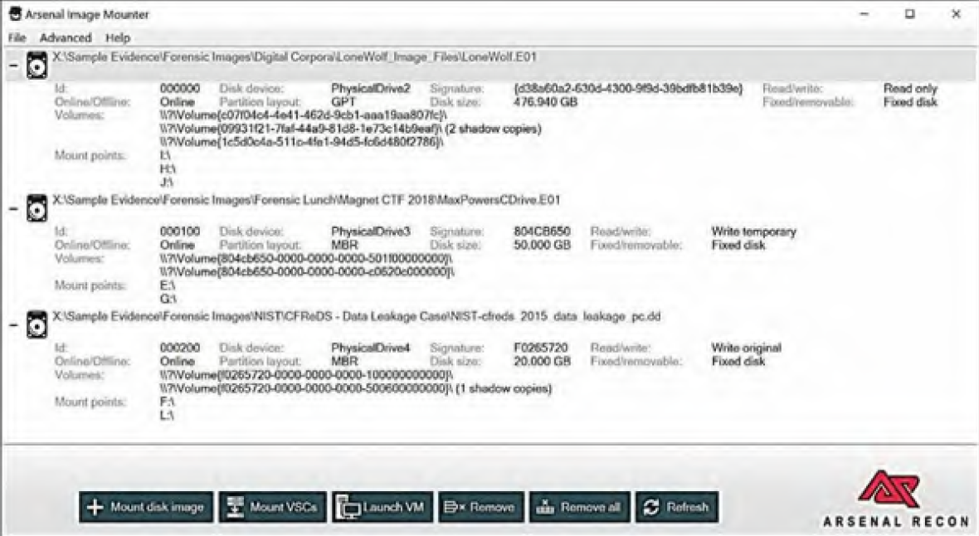
Arsenal Image Mounter
It can mount a forensic image as entire drives in Windows

Slide 4
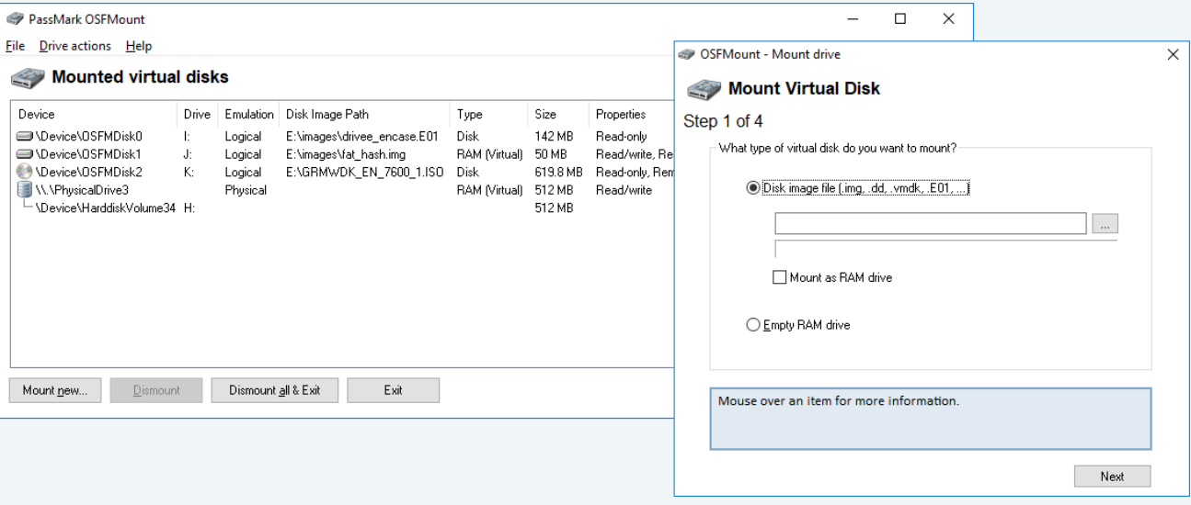
OSFMount
Image Format
Raw Image (.IMG, .DD)
Raw CD Image (.ISO, .BIN)
Split Raw Image (.00n)
Nero Burning ROM Image (.NRG)
System Deployment Image (.SDI)
Advanced Forensics Format Images* (AFF)
Advanced Forensics Format Images w/ meta data* (AFM)
Advanced Forensics Format Directories* (AFD)
VMWare Image (.VMDK)
EnCase EWF (.E01)
SMART EWF (.S01)
VHD Image (.VHD)

Slide 5
Diskpart
Diskpart
Select Volume
Assign/Remove
diskpart
list volume
select volume <VOLUME NUMBER>
assign letter=<LETTER>
Or
remove

Slide 6
“net use” command
Syntax
E.g
net use [{<DeviceName> | *}] [\\<ComputerName>\<ShareName>[\<volume>]] [{<Password> | *}]]
[/user:[<DomainName>\]<UserName] >[/user:[<DottedDomainName>\]<UserName>]
[/user: [<UserName@DottedDomainName>] [/savecred] [/smartcard] [{/delete |
/persistent:{yes | no}}]
net use [<DeviceName> [/home[{<Password> | *}] [/delete:{yes | no}]]
net use [/persistent:{yes | no}]
net use d:\\server\share /user:Accounts\User1
DriveLetter$: It's a shared root partition or volume.
E.g C$ and D$.
ADMIN$: It's a resource that is used during remote administration of a computer.
IPC$: It's a resource that shares the named pipes that you must have for communication between programs..
NETLOGON: It's a resource that is used on domain controllers.
SYSVOL: It's a resource that is used on domain controllers.
PRINT$: It's a resource that is used during the remote administration of printers.
FAX$: It's a shared folder on a server that is used by fax clients during fax transmission.

Slide 7
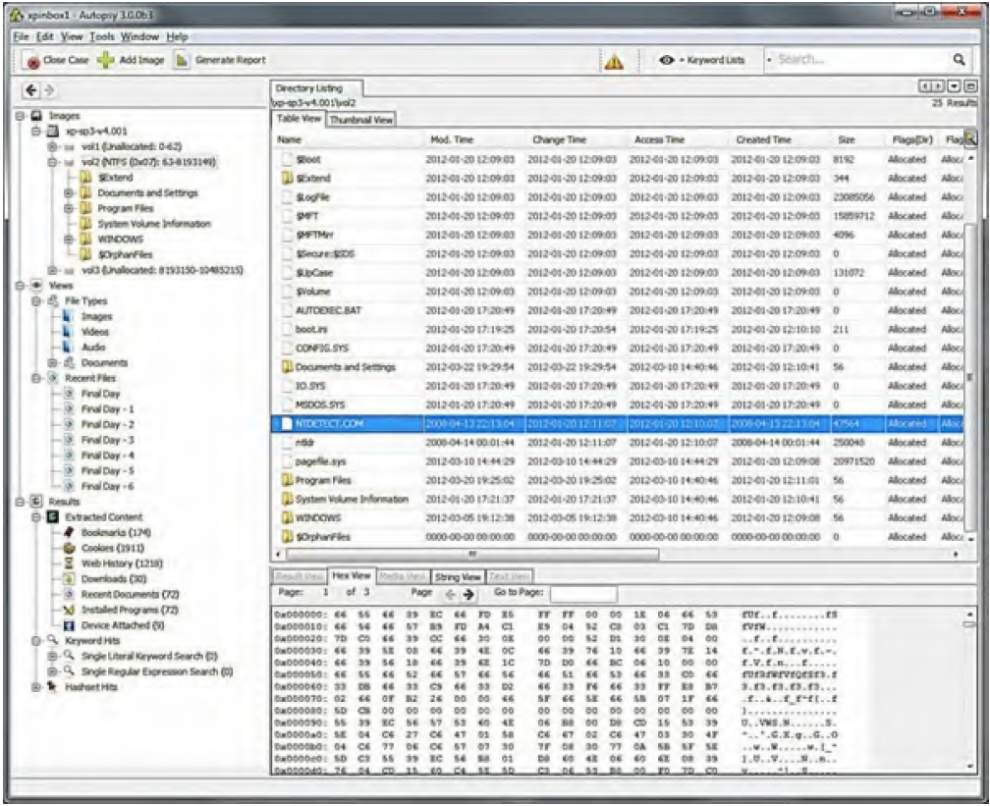
Autopsy

Slide 8
Sleuth Kit
http://www.sleuthkit.org/sleuthkit/
Sleuth Kit® (TSK) is a library and collection of command-line tools that allow you to investigate disk images.
The core functionality of TSK allows you to analyze volume and file system data

Slide 9
Analyzing RAM forensic image
Memoryze
Redline (FireEye)
Volatility

Slide 10
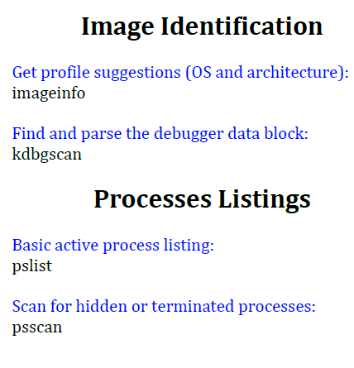
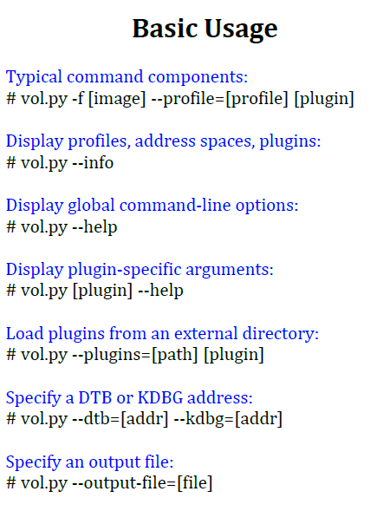
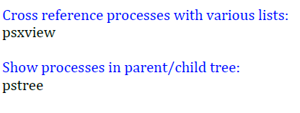
Volatility
https://downloads.volatilityfoundation.org
Install
Usage

Slide 11
…more at
https://downloads.volatilityfoundation.org/releases/2.4/CheatSheet_v2.4.pdf

Slide 12
Thực hành
Dump RAM bằng Magnet RAM hoặc Belfsoft RAM Capturer
Cài đặt Volatility (v3)
Phân tích RAM image (thu thập được ở bước 1)
Phiên bản HĐH và các thông tin liên quan
Thông tin về Kernel của HĐH
Liệt kê các tiến trình đang chạy
Lấy thông tin về các user của hệ thống

